Slide 1


Social Media Analysis
Madan Yadav BG In association with Newton School

Slide 2

Agenda
Problem Statement
Data Description
Objective Key Metrics and Visualizations
Subjective Question for Insights

Slide 3
Meta Overview
In the early days of 2004, a young Mark Zuckerberg sparked a revolution with the launch of Facebook. This social media platform transformed how we connect, share, and interact online. It was a glimpse into the future of digital interaction. Fast forward to October 2021, a pivotal moment when Facebook rebranded itself as Meta.
As we embark on this thrilling journey into the metaverse, the potential to revolutionize human connection becomes clear. Picture yourself attending a virtual concert, feeling the energy and excitement as if you were there in person. Envision collaborating with colleagues from around the world in a virtual workspace, breaking down geographical barriers. Or simply imagine hanging out with friends in a virtual environment that feels almost indistinguishable from reality. The possibilities are boundless, and Meta stands at the forefront of this extraordinary revolution.

Slide 4
Problem Statement
You are hired as a Data Analyst at Meta and asked to collaborate with Marketing team. Marketing teams wants to leverage Instagram's user data to develop targeted marketing strategies that will increase user engagement, retention, and acquisition. Provide insights and recommendations to address the following objectives

Slide 5
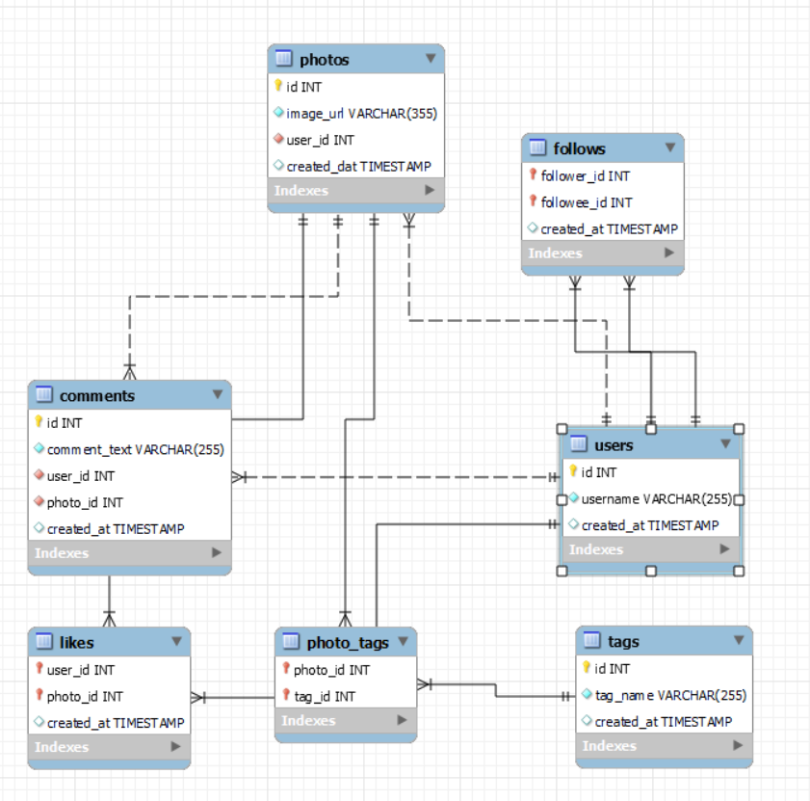
Database Schema

Slide 6
Data Overview
There are overall 7 tables in the Database
photos: id is the unique identifier in the table
follows: follower_id is the unique identifier in the table
users: id is the unique identifier in the table
tags: id is the unique identifier in the table
photo_tags: photo_id is the unique identifier in the table
likes: user_id is the unique identifier in the table
comments: id is the unique identifier in the table
Data Link: Link

Slide 7
Approach
Understanding Statistics: Calculated the total number of users, posts, likes, and comments.
Data Cleaning and Validation: Removed duplicates and treated null values for accurate analysis.
Analysis Techniques: Used Common table expressions(CTE), Aggregate functions, Subqueries, Group by clause and advanced functions like Rank & Window Functions
Data Visualization: Visualized key metrics (total posts, likes, comments). Created charts and graphs to rank users by engagement rates. Highlighted the most influential hashtags
Strategy Making: Developed plans to increase user retention and engagement activities
Implementation: Discussed the implementation of strategies for optimized results.

Slide 8
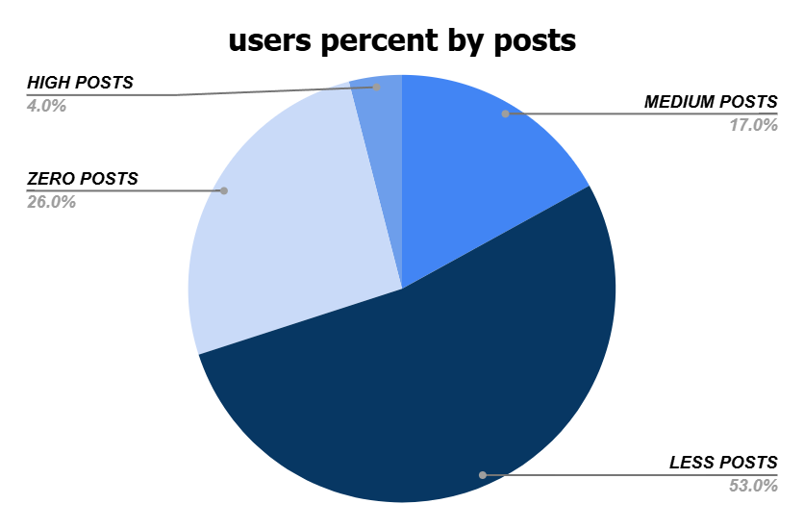
User Activity Distribution
User activities consists of posts, likes and comments
Given Pie Chart represents the percentage wise distribution of posts
As we can observe the distribution is as follows:
Less Posts > Zero Posts > Medium Posts > High Posts

Slide 9
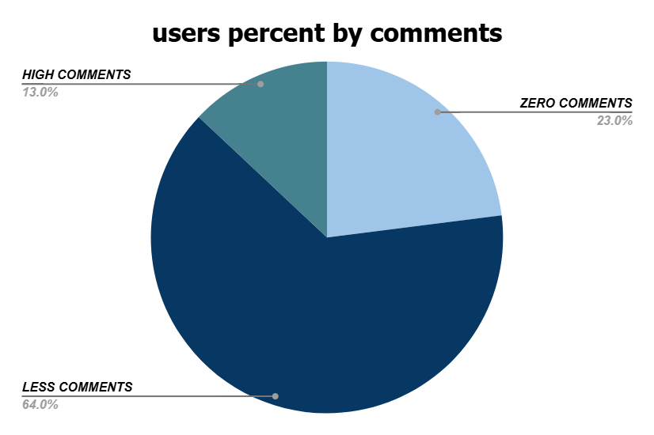
User Activity Distribution
Given Pie Chart represents the percentage wise distribution of comments
As we can observe the distribution is as follows:
Less Comments > Zero Comments > High Comments

Slide 10
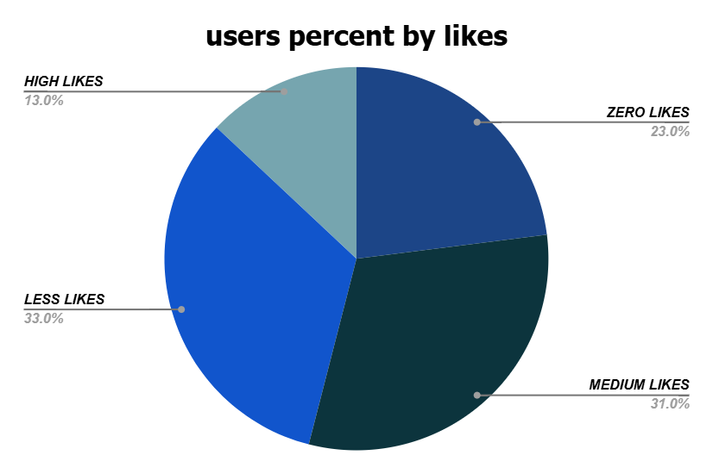
User Activity Distribution
Given Pie Chart represents the percentage wise distribution of likes
As we can observe the distribution is as follows:
Less Likes > Medium Likes > Zero Likes > High Likes

Slide 11
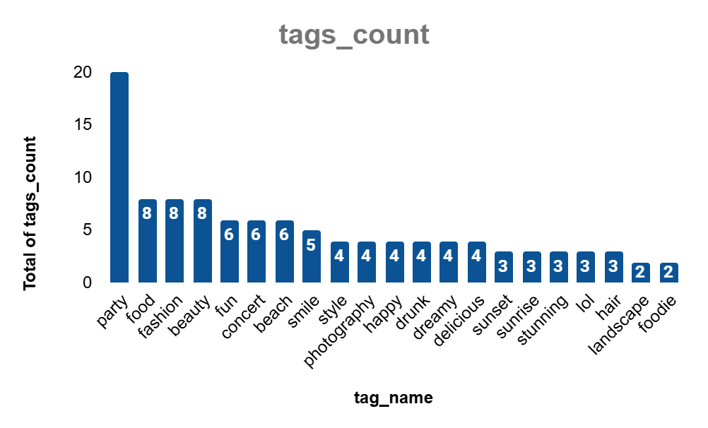
Hashtags Analysis for Personalized and Engaging Ad Campaigns
From the given chart we can observe that:
party is the most used tag by users
foodie is the least used tag by users
beauty, food, fashion, smile, beach, concert and fun are also some of the other tags which were used more by the users

Slide 12
Recommendations for more Personalized and Engaging Ad Campaigns
Our data reveals that "Party“ is the most popular tag among users, we can use vibrant imagery and dynamic videos showcasing epic parties, dance floors, and celebrations. This campaign can target users who frequently engage with party-related content, promoting event tickets, party accessories, or venues.
Both "food" and "foodie" appear in the data, with "food" being more popular. A campaign featuring mouth-watering dishes, recipes, and dining experiences can resonate well. Collaborate with popular food influencers to create content that showcases delicious meals, cooking tutorials, and restaurant reviews.
Tags like "fashion" and "beauty" are equally popular, indicating a keen interest in personal style and aesthetics. An ad campaign focused on the latest fashion trends, beauty tips, and style guides can captivate this audience

Slide 13
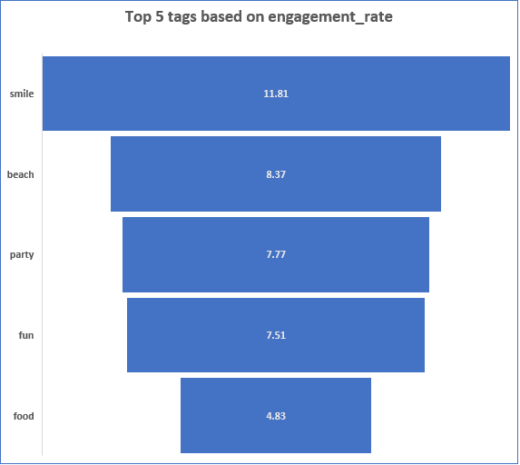
Engagement Rates
Harnessing the Power of Hashtags for Campaign Success
To truly captivate your audience and elevate campaign performance, identifying and leveraging high-engagement hashtags is key. These hashtags are associated with posts that have attracted significant likes, comments, and shares, turning them into a goldmine for content strategy and ad campaigns.

Slide 14
Strategies to guide content strategy and ad campaigns
Spread the Joy with #Smile
Content Strategy: Create uplifting and positive posts that capture genuine smiles and happy moments. Use #Smile to boost visibility and engagement
Ad Campaign: Promote products or services that bring joy, like wellness programs, holiday packages, or happiness quotes. Highlight how they make life brighter.
Embrace the Adventure with #Beach
Content Strategy: Post stunning beach photos, travel guides, and relaxing seascapes. Use #Beach to attract travel enthusiasts and nature lovers.
Ad Campaign: Advertise beach resorts, travel gear, or summer clothing. Emphasize the serene and adventurous aspects of beach vacations.
Celebrate with #Party
Content Strategy: Share vibrant party scenes, event highlights, and celebration tips. Use #Party to engage users looking for fun and excitement.
Ad Campaign: Promote event planning services, party supplies, or nightlife venues. Showcase how your brand can make parties unforgettable.
Capture Fun Moments with #Fun
Content Strategy: Post entertaining and light-hearted content, from funny videos to playful activities. Use #Fun to attract a wide audience seeking amusement.
Ad Campaign: Advertise games, amusement parks, or humor-related products. Highlight the fun and enjoyment they bring.
Satisfy Cravings with #Food
Content Strategy: Share delicious recipes, food photography, and culinary tips. Use #Food to engage food enthusiasts and chefs.
Ad Campaign: Promote restaurants, cooking classes, or food products. Emphasize the taste and quality of your offerings.

Slide 15
Suggested Candidates for Influencer Marketing
Above insights are calculated by summing up the total number of likes and comments on their posts and dividing it by their total number of followers
Filtered out users with less than 1000 followers and an engagement rate below 5% to ensure only users with a significant following and high engagement rates are considered for influencer marketing campaigns.

Slide 16
Recommendations to approach and collaborate with these Influencers
1. Personal Connection
Start by making a personal connection. Imagine receiving a message that stands out: “Hey [Influencer's Name], we’ve been huge fans of your content here at Instagram! Your amazing engagement rates and unique style truly inspire us. We’d love to collaborate and create something extraordinary together!”
2. Highlight the Value
Show them what’s in it for them. Paint a picture of the mutual benefits: “By partnering with Instagram, you’ll have access to exclusive features, promotional support, and opportunities to reach an even larger audience. Together, we can amplify your influence and create content that your followers will love.”
3. Showcase Previous Success
Share stories of past successful collaborations to build trust: “We’ve previously worked with influencers like [Example Influencer], and the results were phenomenal! Their engagement soared, and their followers loved the exclusive content we created together. We believe we can achieve similar success with you.”
4. Offer Creative Freedom
Respect their creative vision and give them space to innovate: “We value your unique voice and creativity. Our collaboration will be a blend of your distinctive style and our innovative features. Let’s brainstorm ideas and create something that truly resonates with your audience.”
5. Provide Clear Next Steps
Make it easy for them to say yes by outlining clear steps: “If you’re interested, let’s set up a quick call to discuss potential ideas and see how we can make this partnership incredible. We can’t wait to explore this opportunity with you!”

Slide 17
Conclusion
High Engagement Users:
Start by analyzing user activity data to find those with the highest engagement rates. These are the users who consistently like, comment, and share content. Their active participation and diverse tag usage make them ideal candidates for brand ambassadorship.
Influential Interactors:
Look for users who have a significant influence on their followers. These individuals may not have the largest follower count, but their posts generate a high level of interaction. Their ability to engage and inspire others makes them valuable advocates for promoting initiatives and events.
Tag-Based Enthusiasts:
Examine the tags that users frequently engage with. Identify those who are passionate about specific topics like food, photography, or fashion. These users can be segmented based on their tag preferences, allowing you to match them with relevant campaigns that align with their interests.
Consistent Contributors:
Focus on users who consistently create and share high-quality content. Regular posting and a strong visual aesthetic are key indicators of potential brand ambassadors. Their dedication to content creation ensures they can effectively represent Instagram’s initiatives.
Engagement Growth Patterns:
Identify users who have shown significant growth in their engagement metrics over time. These rising stars are often on an upward trajectory and can bring fresh energy and enthusiasm to your campaigns.

Slide 18
Thank You

